Slide 1
Integrated Design Project/Capstone Project II (IDP-II) Sessional
Introduction & Overview
Lec Tarannum Zaki
Dept. of CSE
MIST
CSE 460
Credit Hr: 3.00
Contact Hr: 6.00

Slide 2
Course Instructors
Lt Cdr S M Anisur Rahman
Assistant Professor Abdullah Al Iftekhar Ahmed
Lec Tarannum Zaki
Lec Sahrima Jannat Oishwee
Lec Muhaimin Bin Munir
Lec Shahriar Rahman Khan

Slide 3
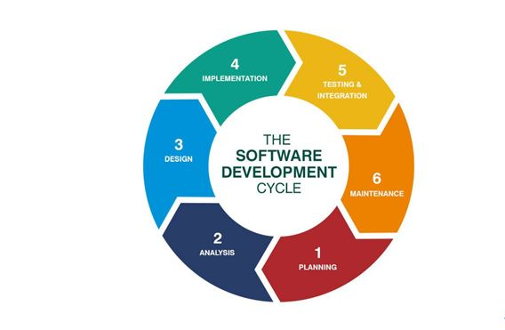
Software Development Life Cycle

Slide 4
Process Overview
Incorporate changes if necessary
Incorporate changes if necessary
*Each phase will have necessary presentation and evaluation
Phase 1
Topic Submission
Phase 2
Methodology
Phase 3
Design & Partial Implementation (Prototype/Demo)
Phase 4
Complete Implementation
Phase 5
Report Evaluation
Final Evaluation
Testing & Result Analysis
Literature Review
Objective
Report Generation
Final Observation & Correction
Evaluation Committee (Supervisor + Other members)
Training 1
Training 2
Training 3

Slide 5
Course Outcomes
CO1: Design appropriate tests to measure and evaluate the performance of prototype subsystems to determine whether they meet performance and interface requirements considering ethical, financial and environmental issues and recommend changes.
CO2: Constructively contribute to the accomplishments of a multidisciplinary team, including critical evaluation of self and team-member performance.
CO3: Communicate the team’s logistical and technical approaches to the design project in a polished, co-authored, written proposal, using language and graphics appropriate to the technical discipline.
CO4: Succinctly report individual and team performance against the plan.
CO5: Describe organizational and technical plans and progress in oral presentations, using high-quality, informative, graphical and textual elements.

Slide 6
Course Planning (Tentative)
Week | Milestones | Regular Assessment
1,2 | Introductory session and orientation with different software | Discussion and updates on different documentations
3 | Frontend and changes (if) from UI design done in previous term
4 | Orientation with different software
5,6 | Backend (to some extent)
7,8 | 60~70% update on software
9,10 | Regular updates
11,12 | Discussion on experimental results
13,14 | Final presentation/Viva, Project display, Project submission. | Final Assessment

Slide 7
Course Assessment
Total assessment will be done on a total of 150 marks combinedly (HW and SW lab).
All the documentation of SW lab are preferred to be done in LaTex.
Regular assessment will be done on your project and documentation (group wise & individually).
Teamwork assessment will be considered from both sides (teachers and students).

Slide 8
Project Documentation
1) Project scheduling (.mpp file)
2) Project proposal document (PDF file)
3) SRS document (PDF file)
4) Final presentation (PPT file)
5) UI design document (PDF)

Slide 9
Project Documentation
1) Updated SRS document (PDF)
2) Project plan document (PDF)
3) Updated project scheduling softcopy (.mpp file)
4) Report - paper format (PDF)
5) Software quality assurance document (PDF)
6) Software testing document (PDF)
7) User manual document (PDF)
8) Help file softcopy (.chm file)
9) Experiment design document (PDF)
10) Updated UI Design document (PDF)
11) System development document (PDF)
12) Software/Hardware system files (if possible)
- this includes background files of your project development such as source codes
13) Video file of demonstration
14) Final presentation (PPT)
15) Teamwork Assessment

Slide 10

Open Source SW Development and Version Control Platform

Slide 11
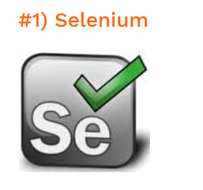


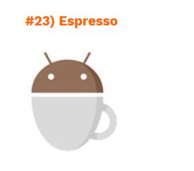
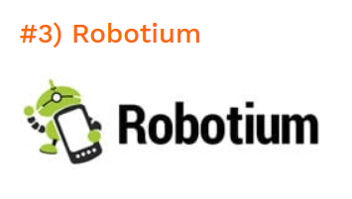

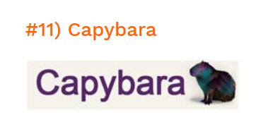
SW Testing Open Source Tools

Slide 12
THANK YOU

